Slide 1
Notes:
BRING FOLDER OF MATERIALS UP FRONT.
Welcome – 4th MOScholars Partner School Training
We have new partnering schools and partnering schools that have been with us since the beginning. We are thankful to have you here.
We have 38 attendees representing over 23 partner schools
Reference Materials - Back of the agenda listing
Today is about our partnership with you.

Slide 2
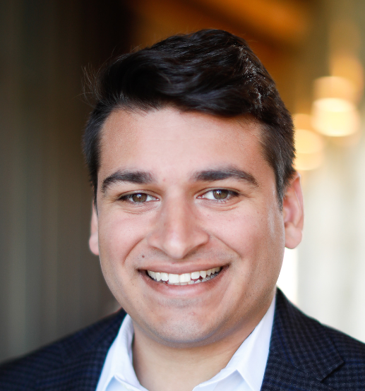
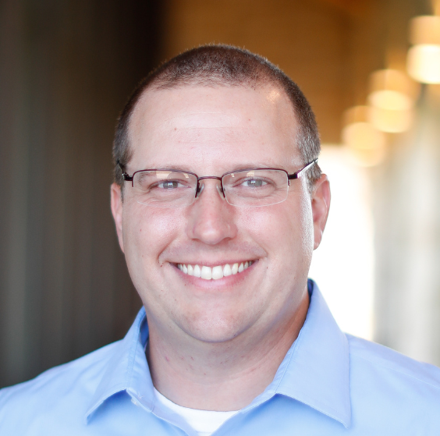
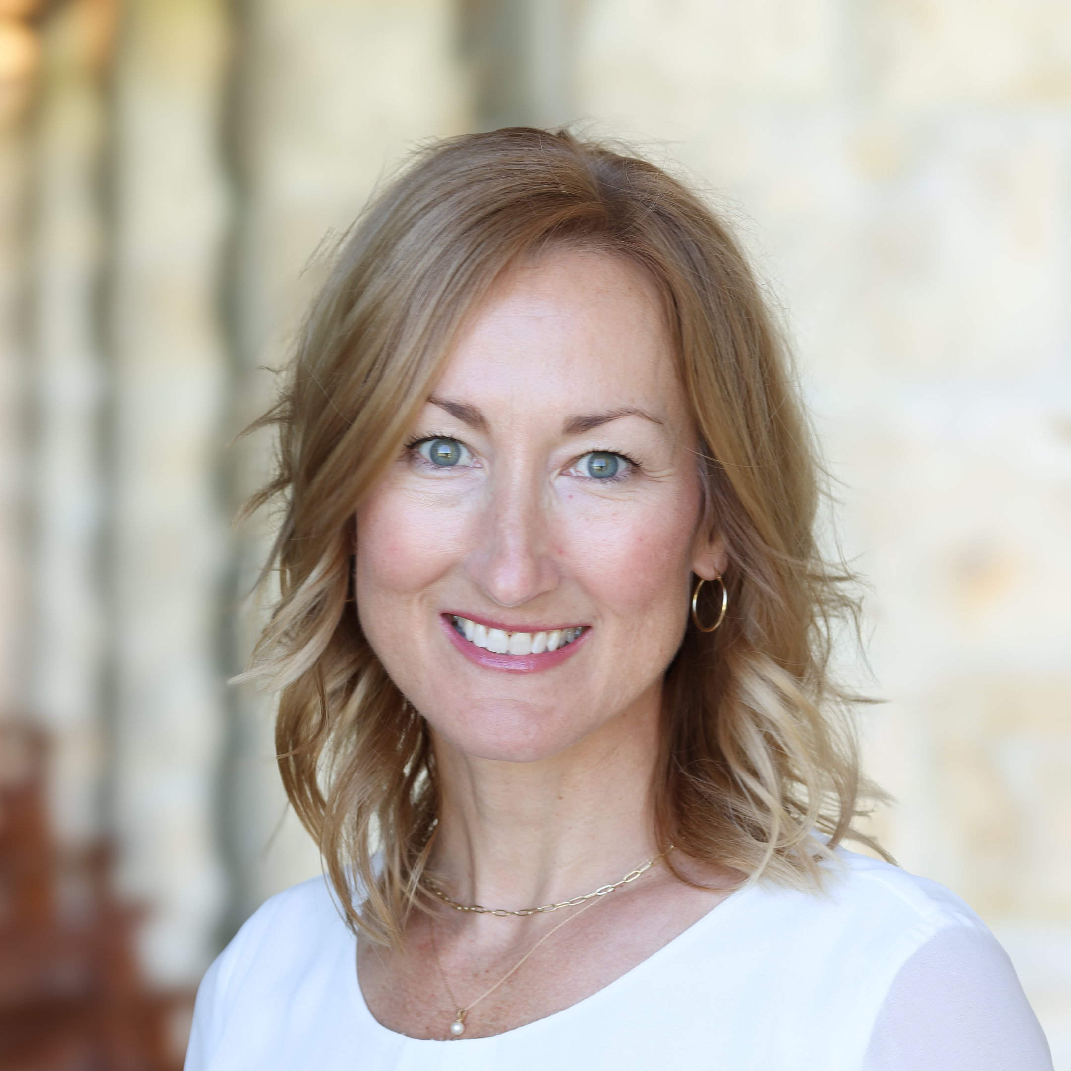
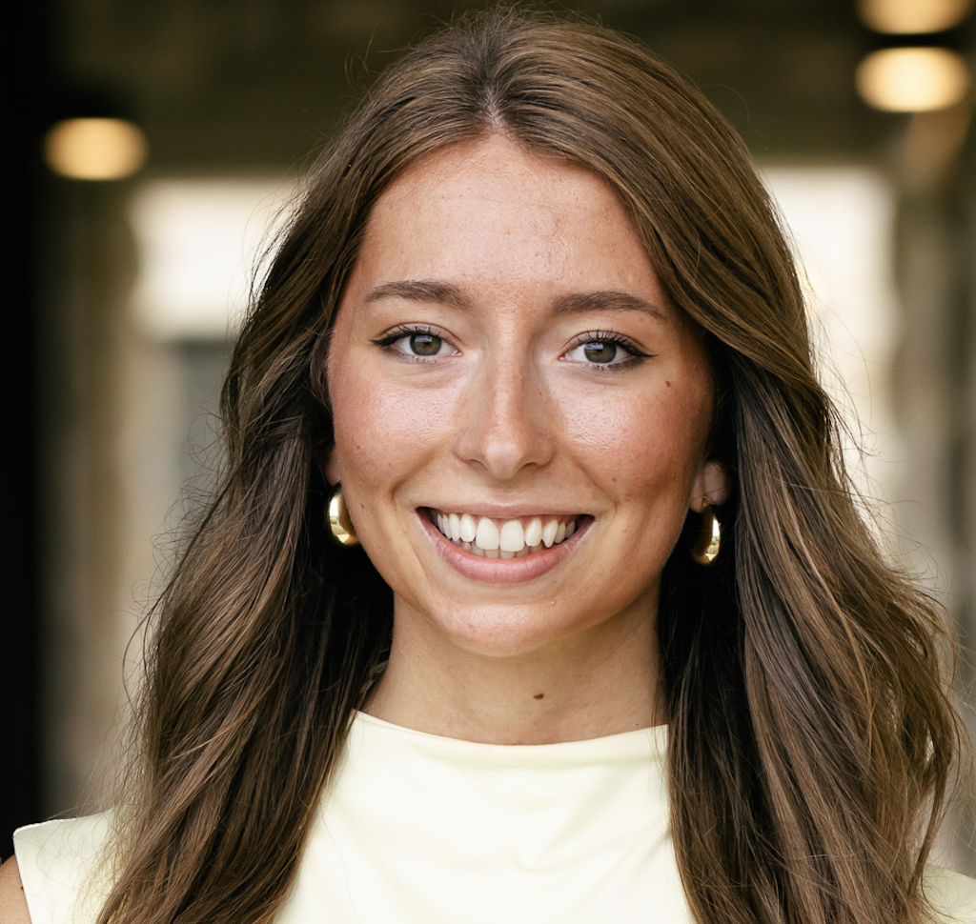
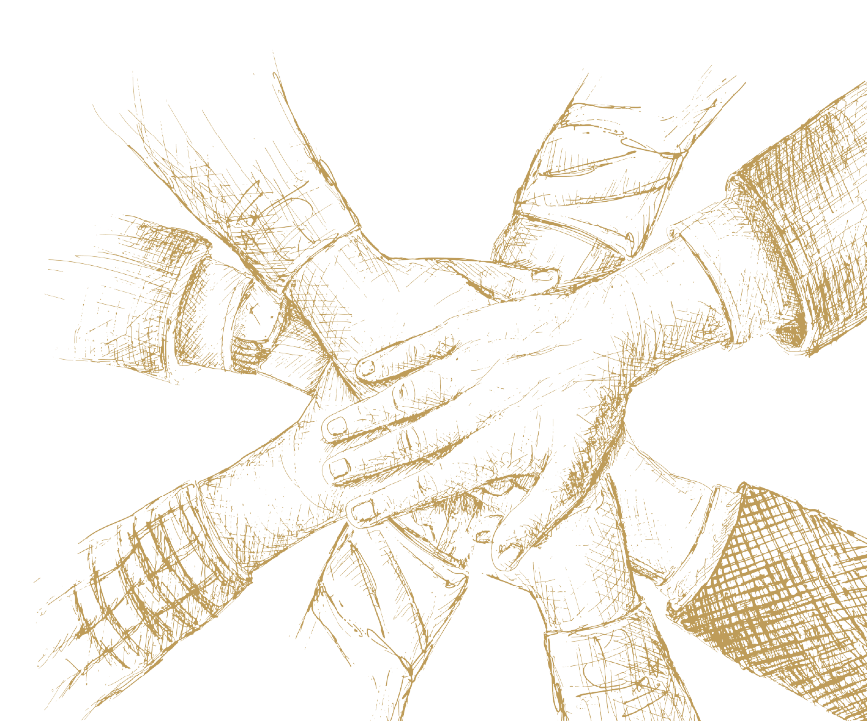
Our Team
Chris Vas
Scholarship Director
Josh Hurlbert
Scholarship Coordinator
Kristi Miller
Development Associate
Jenna Larson
Administrative Assistant

Slide 3

Who Qualifies?
A legal Missouri resident who meets one of these four conditions:
1. Has a formal IEP/ISP issued within the past 36 months;
OR
2. Has a household income under 300% of the reduced lunch threshold (for a family of four, $183,150 this year) AND either:
  a. Going into K or 1st Grade; OR
  b. Attended public school for a semester the immediate prior year; OR
  c. Is a sibling of a renewal scholarship student.

Slide 4

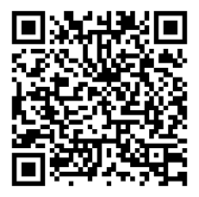
Who Qualifies?
The State Treasurer's Office closed this application window closed April 3.
Parents can sign up for our interest list at
herzogmoscholars.org/qualification-check

Slide 5
Who Qualified?
2,407 renewals
+
4,303 new applicants
---
1,903 – Qualified
980 – Pending FACTS review
1,420 – Incomplete/Not Qualified

Slide 6

In what order are they awarded?
(#s as of 4/10/26)
1) Renewal scholarships - 2,407
2) Siblings of renewals - 29% of qualified new students
3) IEP/Dyslexia students – 13%
4) Free lunch student in unaccredited school districts - >1%
    (max income for a family of 4 = $42,900)
5) Reduced lunch student in unaccredited school districts - >1%
    (max income for a family of 4 = $61,050)
6) Rest of free lunch students – 8%
7) Rest of reduced lunch students – 7%
8) Active duty military students enrolling in Missouri for the first time - >1%
9) Everyone else under 300% - 43%
    (max income for a family of 4 = $183,150)

Slide 7
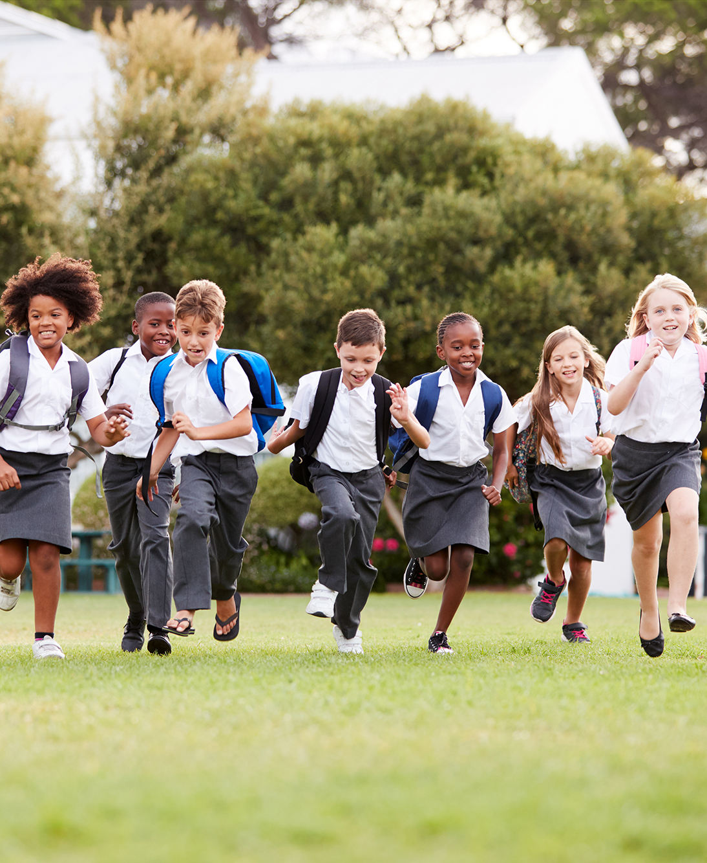
Scholarship Details
$7,145, pending legislative action
Tuition, tutoring, technology
Received through 12th grade

