Slide 1
Website Communication
Notes:
BRING FOLDER OF MATERIALS UP FRONT.
Welcome - 3rd MOScholars Partner Training
We have new partnering schools and partnering schools that have been with us since the beginning. We are thankful to have you here.
We have 45 attendees representing over 25 partner schools
Building the plane as we were flying it
Today is about our partnership.
Back of the agenda listing
Reference Materials

Slide 2
Types of Digital Partnership
Option #1
Site Link
Graphic or text linking to MOScholars / Herzog Tomorrow website.
Option #2
MOScholar Page
Explain tax credits, embed videos, & link MOScholars / Herzog Tomorrow.
Notes:
Step #1 –I will actually show you the treasurer’s website and walk you through a reservation on the next slide.
Step #2 – By selecting HTF, we will see your reservation and begin communicating with you to walk you to walk you through the next step
Step #3 – Donate that amount you reserved to HTF. (Reservation must be done first per the state statute – cannot donate first).
-With each communication, we ask supporters if they are affiliated with a school and keep track of that internally. So when you are promoting MOScholars with your community, it’s great to remind them to let us know!
-We process your proof of donation with the state.
-State issues a tax credit certificate
-This is kept to use when filing 2025 taxes in spring of 2026. You will use a tax credit form when filing taxes called MO-TC.
-We have a couple of resources for schools to use to share about the tax credit process. 1) a 1 minute video. 2) Our bifold – located in the folder/giving you a bundle to take with you today.

Slide 3
Visibility
Where should it go?
  Admissions
  Financial Aid
  About Us
  Parent Portal
  Scholarships

Slide 4
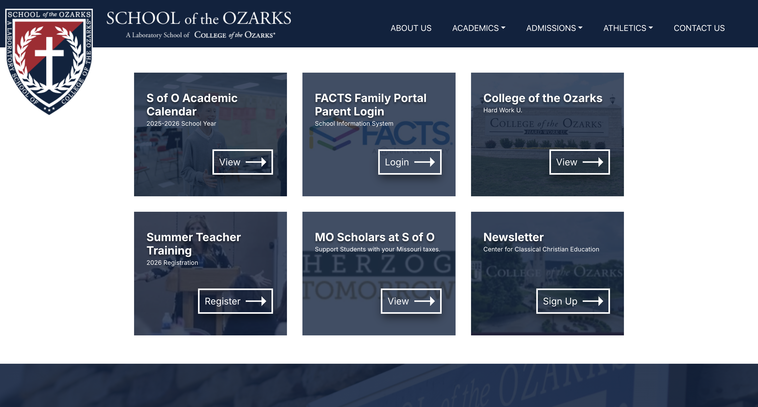

Slide 5


Slide 6
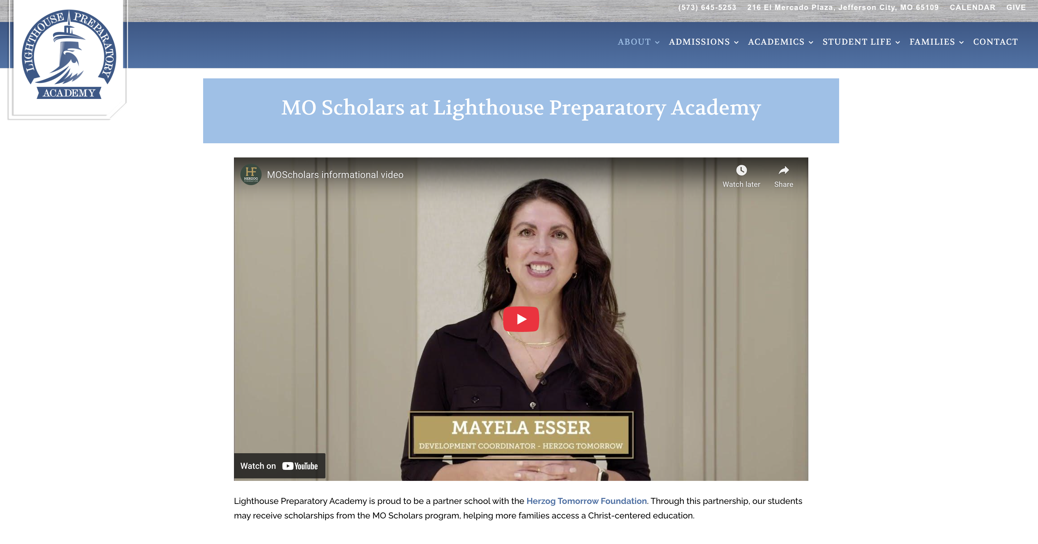

Slide 7
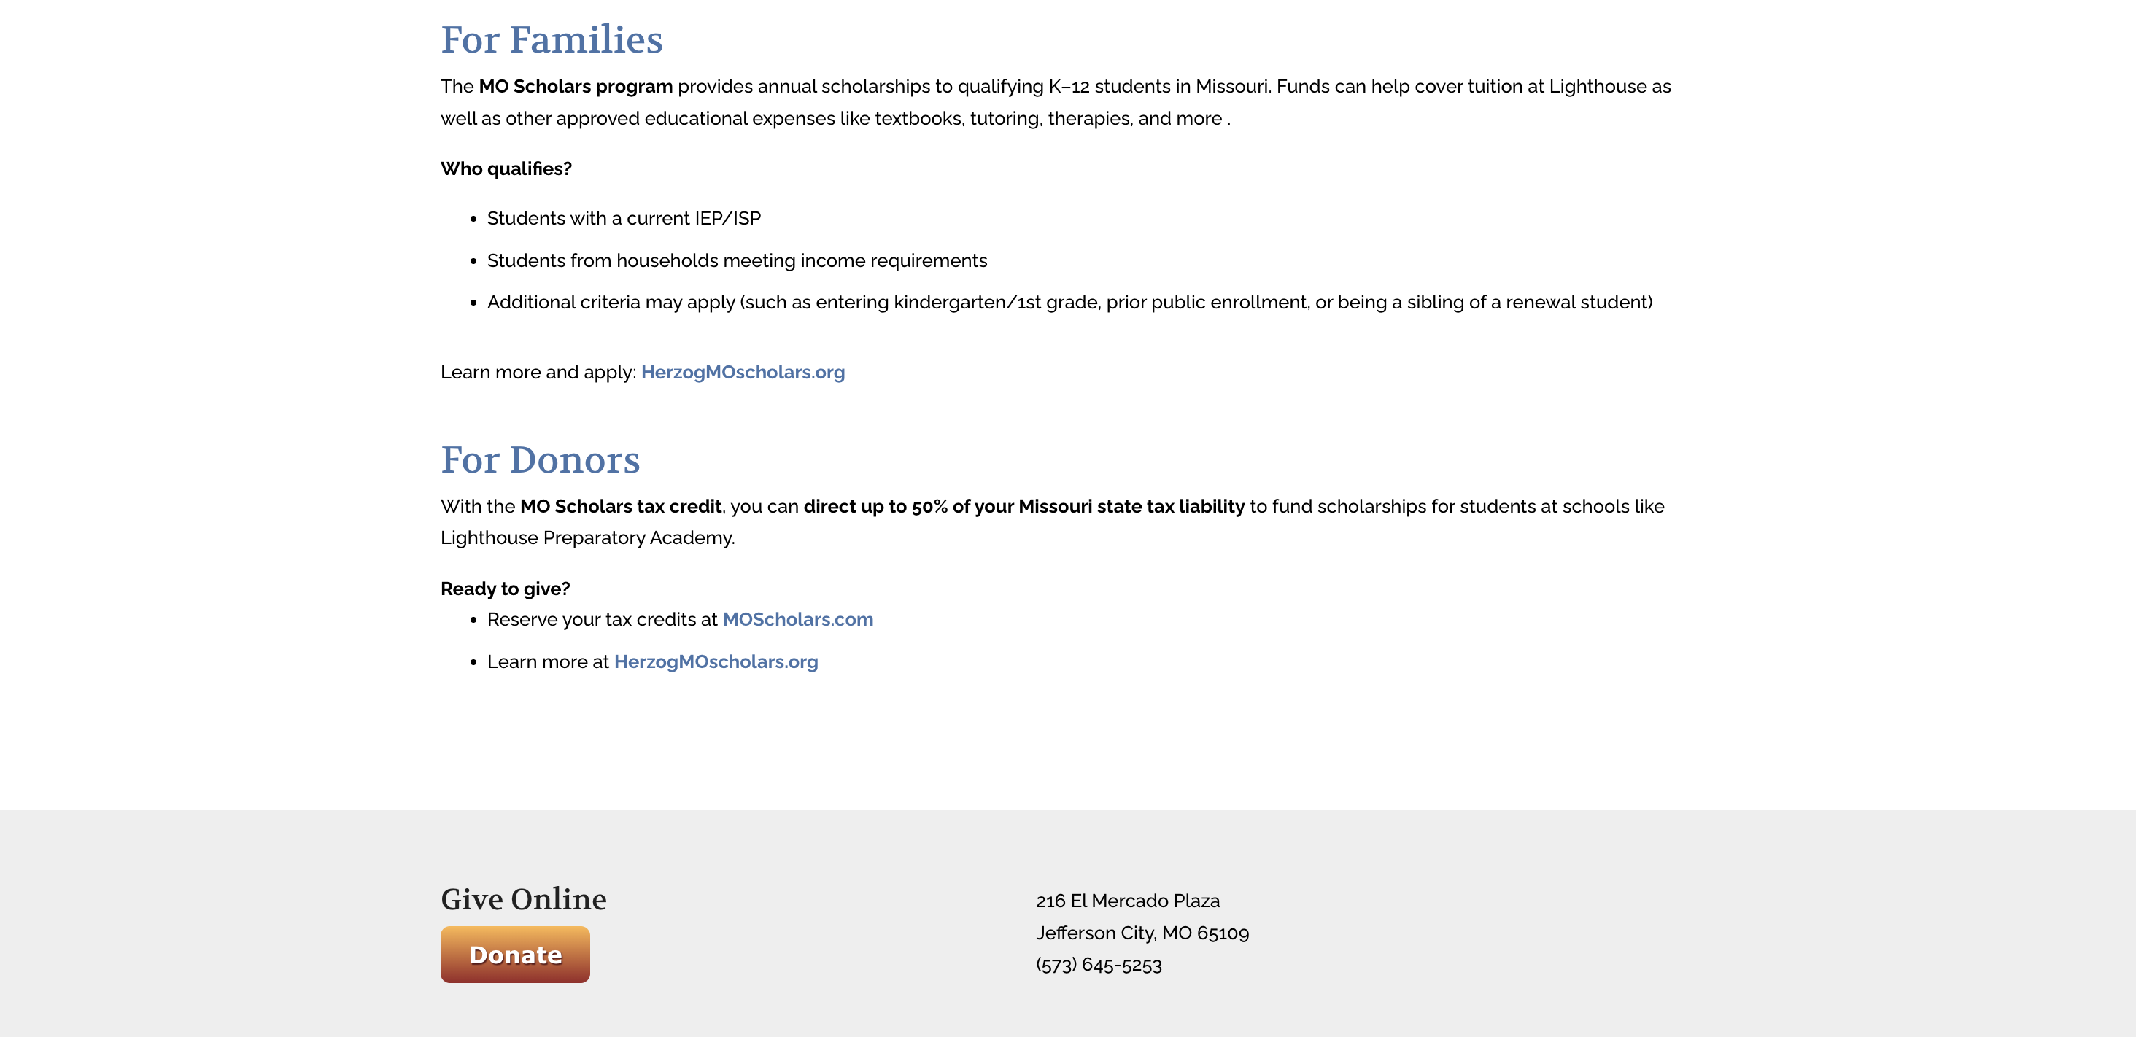

Slide 8
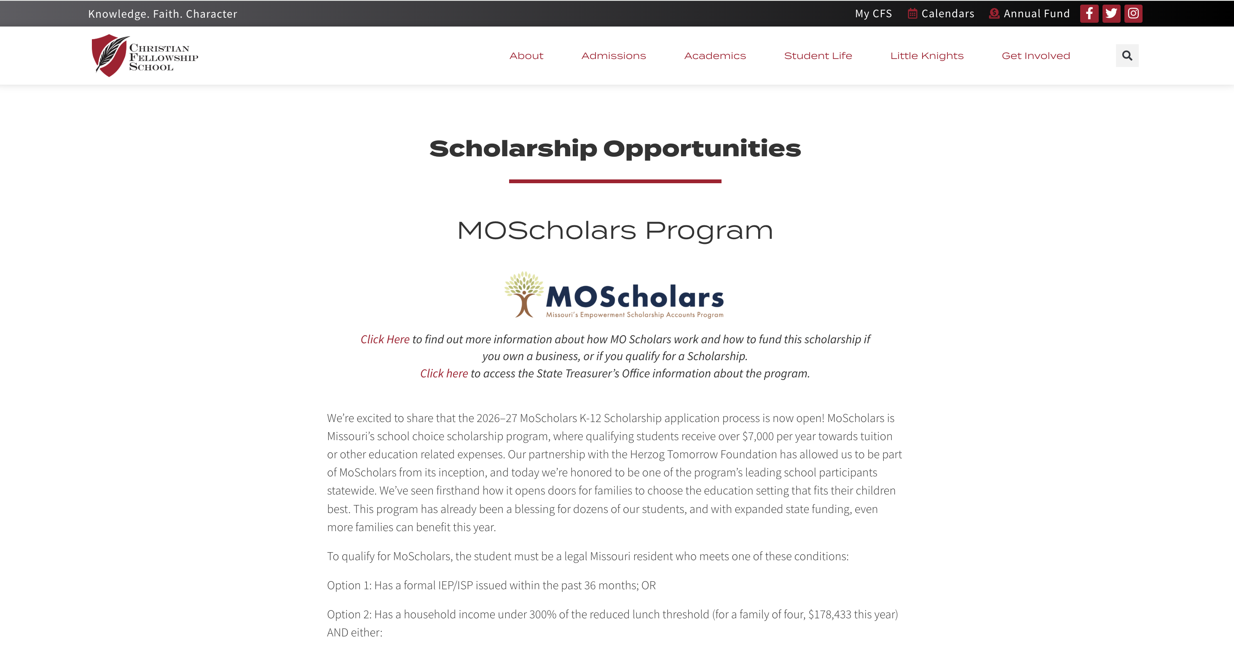

Slide 9
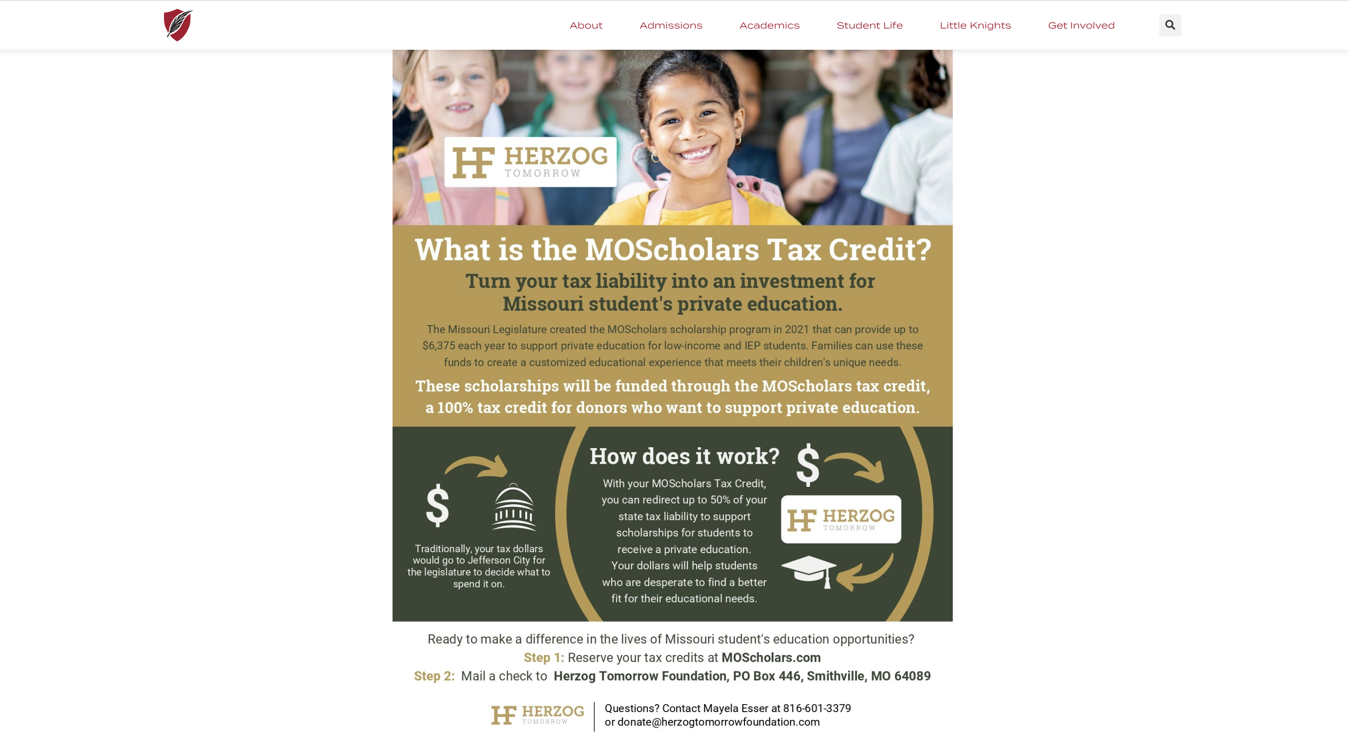

Slide 10

Participation
Developer
Contract with website builder
$100 per hour / Most Expense
School Staff
Experience within school staff
School Parent
Expertise within school community

