Slide 1

Notes:
-At this time, we want to give an overview of how MOScholars scholarships are supported.
-First of all, I know we have current supporters in the room who have chosen to redirect their taxes to support scholarships – thank you!
-I do encourage everyone in the room to consider participating in the process in 2025. Not only to actively support students at your school, but it will also give you firsthand experience on how easy the process is which will ultimately help you to share and gain support from your community.
-Again, this is just an overview of the process for you. We are here to educate you but we don’t expect you to be experts – that is our job and we welcome you to send people our way.
-So, how does it work?
-This is a REDIRECTION OF TAXES. Supporter receives a $1 for $1 TAX CREDIT for their contribution to HTF. HTF turns your contribution into scholarships.

Slide 2

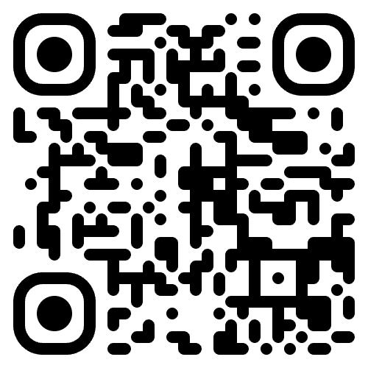
For more information:
Fill out the donate form at HerzogMOScholars.org

